Slide 1
Player Tutorial
Boyoon Jung
Robotic Embedded Systems Lab
Robotics Research Lab
Center for Robotics and Embedded Systems

Slide 2
Player/Stage/Gazebo
Player
  Device server that provides a powerful, flexible interface to a variety of sensors and actuators
Stage
  2D, multi-robot simulator
Gazebo
  3D, dynamic, multi-robot simulator

Slide 3
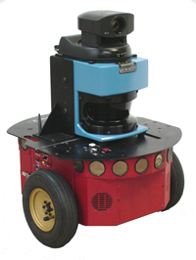
Robot Programming
User Program
Camera
PCI
Sensory
Data
Acquisition
Laser
USB
Sonar
Serial
Planner
…
Odometry
Motor
Command
Generation
Desired
Motion
Motors
Serial
Canbus
…

Slide 4
Player: a device server
Player
User Program
Camera
PCI
Sensory
Data
Acquisition
Laser
USB
Sonar
Serial
Planner
…
Odometry
Motor
Command
Generation
Desired
Motion
Motors
Serial
Canbus
…

Slide 5
Client / Server Model
Player Server
Device driver Interface
TCP/IP
Player
Client
Library
C/C++
C#
Java
Tcl
Python
Ruby
Lisp
Octave
SICK
LMS 200
sicklms200
laser
Data
SICK
PLS
sickpls
laser
Configuration
User
Program
Pioneer
p2os
position
Command
Segway
segwayrmp
position
position
IPC
Khepera
khepera

Slide 6
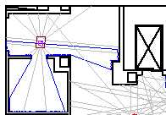
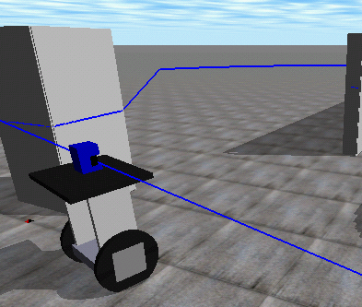
Hardware Abstraction
Player
Client
Library
C/C++
C#
Java
Tcl
Python
Ruby
Lisp
Octave
Player
Server
Robot
Hardware
Player
Server
Stage
Simulator
User
Program
Gazebo
Simulator
Player
Server

Slide 7
Communication
Player
Server
Player
Client
Library
Establish connection
Subscribe device(s)
Sensor data
Actuator commands
Robot
Hardware
User
Program

Slide 8
Running Player
Building and installation
    http://playerstage.sourceforge.net
    ./configure
    make
    make install
Execution
    player [–p <port>] <config file>
    playerv [hostname:port]
    playerjoy [hostname:port]

Slide 9
Player config file
Player
Server
blobfinder:0 (
driver “acts”
devicepath=“/dev/video0”
channel 0
)
laser:0 (
driver “sicklms200”
port “/dev/ttyS1”
resolution 50
)
position:0 (
driver “p2os_position”
port “/dev/ttyS0”
max_xspeed 500
)
Camera
Laser
Motors

Slide 10
Player Programming
Player client libraries
  C (libplayerc), C++ (libplayerclient), Tcl (tclPlayer), etc.
Programming step
  Establish connection.
  Subscribe device(s).
  Read sensory data.
  Processing.
  Send motor command.
Repeat

Slide 11
Example Code
$PLAYER/examples/c++/laserobstacleavoid.cc
#include <playerclient.h>
char host[256] = “localhost”;
int port = PLAYER_PORTNUM; // 6665
int main(int argc, char **argv)
{
// 1. Establish connection
PlayerClient robot(host, port);
// 2. Subscribe device(s)
PositionProxy pp(&robot, 0, ‘w’);
LaserProxy lp(&robot, 0, ‘r’);

Slide 12
for (;;) // repeat
{
// 3. Read sensory data
if (robot.Read())
exit(1);
// 4. Procesing
...
double l = (1e5*minR)/500 – 100;
double r = (1e5*minL)/500 – 100;
newspeed = (r+1)/1e3;
newturnrate = (r-l)/1e3;
newturnrate = DTOR(min(newturnrate, 40));
newturnrate = DTOR(max(newturnrate, -40));
// 5. Send motor commands
pp.SetSpeed(newspeed, newturnrate);
}
}

Slide 13
Player: an algorithm repository
Player
User Program
Camera
PCI
Sensory
Data
Acquisition
Laser
USB
Sonar
Serial
Planner
…
Odometry
Motor
Command
Generation
Desired
Motion
Motors
Serial
Canbus
…

Slide 14
Computational devices
amcl (Adaptive Monte-Carlo Localization)
vfh (Vector Field Histogram)
position
amcl
localize
laser / sonar / wifi
map
position
position
vfh
lase

Slide 15
Player
A device server
  Hardware abstraction
  Network transparency
  Language independence
An algorithm repository

